Slide 1

Global Superstores: A Timeseries Analysis
Forrest casey
Rachael meinders
David pearcill
Melanie thelen

Slide 2
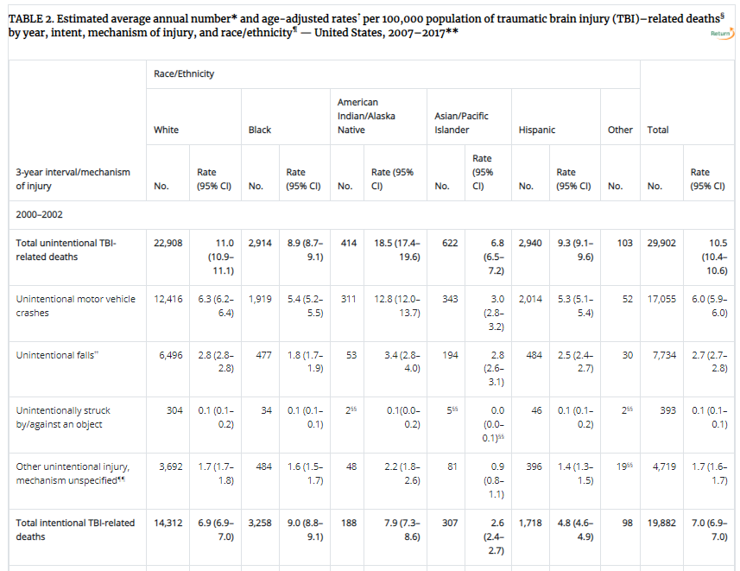

A Black Hole of Indecision
A Black Hole of Indecision

Slide 3
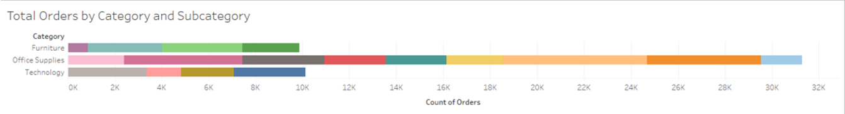
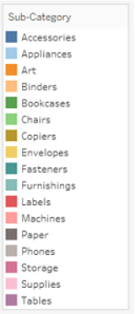
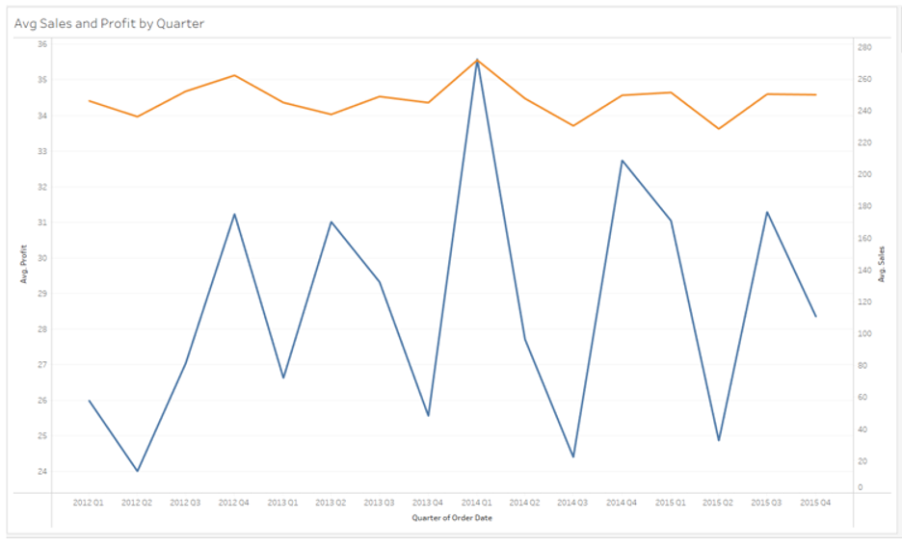
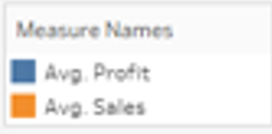
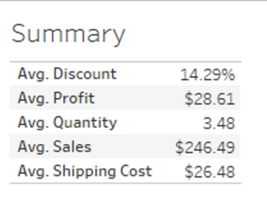
51,290 ROWS & 22 COLUMNS
Notes:
Data was largely clean (minus postal code)

Slide 4
All orders vs top countries
Accuracy across regressions
Notes:
#529985
c26b51

Slide 5

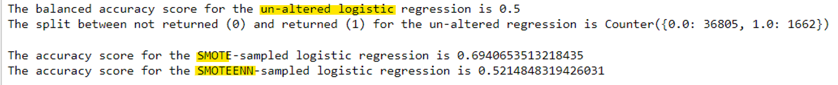
Orders from all countries
Notes:
Profit is unsuccessful due to lack of cost info, we really only have shipping cost
Chose balanced accuracy score due to un-balanced data
Not returned 95.3% of the time – pretty much always threw “no”

Slide 6

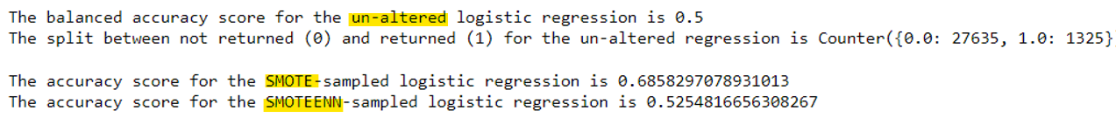
Orders from top countries

Slide 7
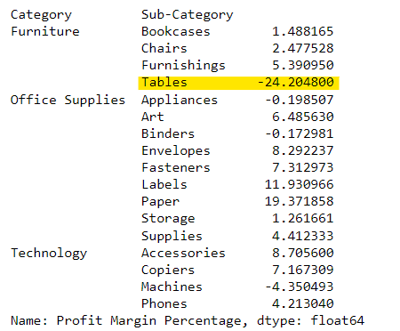
Tables – loss leader
Notes:
Overall profit margin is 3.5%

Slide 8
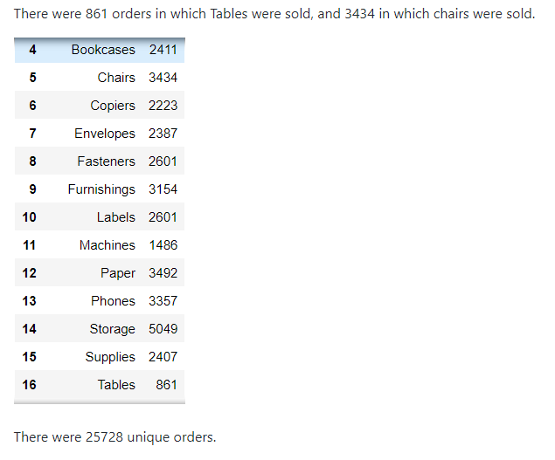
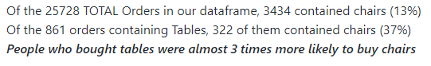

Slide 9
Forecasting future sales & profit
Using facebook prophet
Notes:
Open source code for forecast time series data – works best with strong seasonality & several seasons of historical data

Slide 10
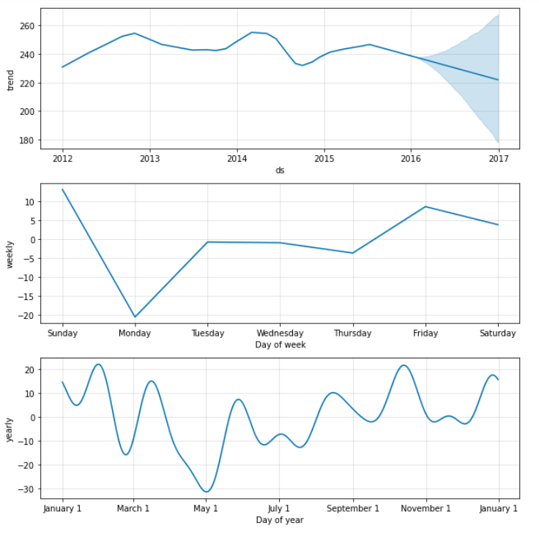
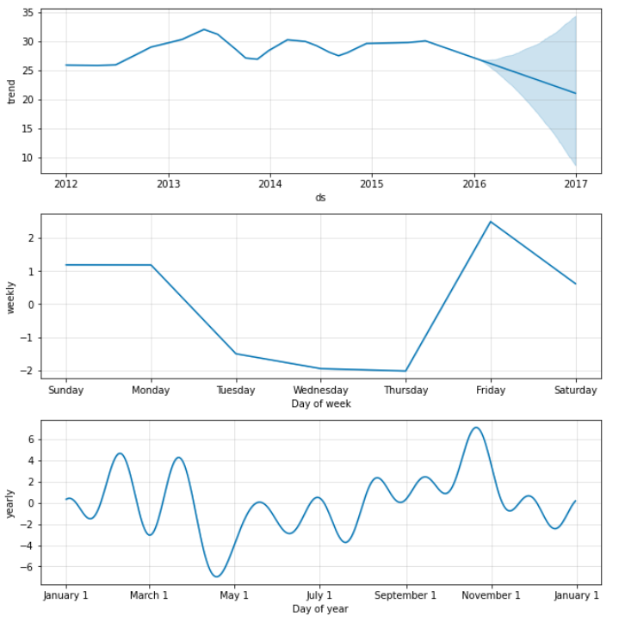
SALES PROFIT

Slide 11
Thank you!

Slide 12
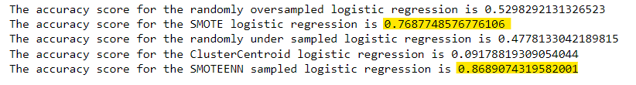
Re-sampling – all orders

Slide 13
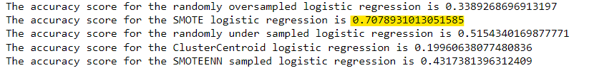
Re-sampling – top countries

Slide 14
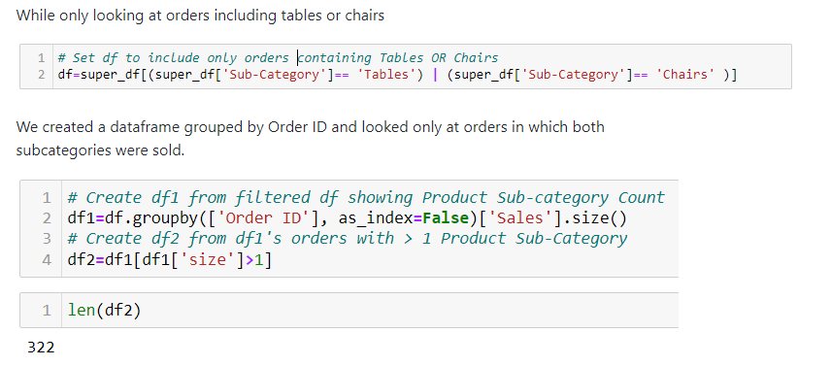
Methodology – tables & chairs

